Slide 1
Student performance Prediction
CAPSTONE PROJECT
Presented By:
Shivam Chauhan
Chandigarh Group of College Jhanjeri , Chandigarh.
Computer Science in Artificial Intelligence & Machine - Learning.

Slide 2
OUTLINE
Problem Statement
Proposed System/Solution
System Development Approach (Technology Used)
Algorithm & Deployment
Result
Conclusion
Future Scope
References

Slide 3
Problem Statement
The education sector continually seeks ways to enhance student performance and provide timely support to struggling students. Predicting student performance based on various factors can be instrumental in identifying at-risk students and tailoring interventions to improve their academic outcomes. This project aims to develop a Student Performance Prediction System using machine learning algorithms to classify students into different performance categories (High, Medium, Low) based on their academic and demographic data.
By leveraging machine learning techniques, the Student Performance Prediction System aims to aid educators in early identification of at-risk students and enhance the overall educational outcomes through data-driven insights and interventions.
To build a machine learning model that can classify students' performance levels accurately based on their academic and demographic data.

Slide 4
Proposed Solution
Data Collection:
Gather the dataset containing student features such as gender, nationality, grade, section, topic, semester, raised
hands, visited resources, announcements viewed, discussions, parent survey responses, parent satisfaction.
Data Preprocessing:
Clean the dataset by removing irrelevant or redundant features.
Encode categorical variables to numerical values for better model compatibility.
Shuffle the dataset to ensure randomness and avoid bias.
Feature Selection:
Identify and retain the most relevant features that significantly impact student performance.

Slide 5
PROPOSED SOLUTION
Deployment: Create a user-friendly interface or application that predicts real-time house prices. Deploy the solution on a scalable and reliable platform, taking into account server infrastructure, response time, and user accessibility.
Evaluation: Evaluate the model's performance using the Mean Absolute Percentage Error (MAPE) metric. Fine-tune the model using feedback and continuous monitoring of prediction accuracy.
Result: Present each model's MAPE and discuss which performed best. All real estate market stakeholders will benefit from this reliable estimate of house prices.

Slide 6
SYSTEM APPROACH
The system approach outlines the overall strategy and methodology for developing and implementing the Student Performace Prediction.
System Requirements:
A computer with a Python environment installed.
Access to the Student Performace dataset.
Sufficient memory and processing power to handle data preprocessing, model training, and prediction.
Libraries Required to Build the Model:
Pandas: Used for data manipulation and analysis. It provides data structures and functions needed to manipulate structured data.
Matplotlib and Seaborn: Used for data visualization. They provide a flexible and powerful declarative framework for creating static, animated, and interactive visualizations in Python.
Scikit-learn: Used for machine learning and statistical modeling including classification, regression, clustering, and dimensionality reduction.
NumPy: Used for numerical computations and working with arrays.

Slide 7
SYSTEM APPROACH
Data Collection: The dataset is collected and loaded into a pandas DataFrame.
Data Preprocessing: The data is cleaned and preprocessed. This includes handling missing values, outliers, and inconsistencies. Feature engineering is performed to extract relevant features from the data that might impact house prices.
Model Building: Several machine learning algorithms are implemented including Support Vector Regressor (SVR), Random Forest Regressor, Decision Tree Regressor, Gradient Boosting Regressor, and K-Nearest Neighbors (KNN). These models are trained and tested on a split of the dataset to predict house prices based on historical patterns.
Model Evaluation: The model’s performance is assessed using the Mean Absolute Percentage Error (MAPE) as the evaluation metric.
Deployment: The final model is deployed to make real-time prediction

Slide 8
Algorithm & Deployment
Data Collection and Preprocessing.
Data Splitting (Training and Testing).
Feature Selection and Encoding.
Decision Tree, Random Forest .
Model Evaluation (Accuracy, Precision, Recall).
K-Nearest Neighbors (KNN): This algorithm assumes that similar things exist in close proximity and predicts
the value of any given point in the dataset by averaging the values of the ‘k’ closest points.

Slide 9
Algorithm & development
Decision Tree Classifier:
Description: The Decision Tree model is a simple yet powerful classification algorithm.
The Decision Tree model correctly classified student performance with an accuracy of 90.5%.
Random Forest Classifier:
Description: The Random Forest model is an ensemble method that combines multiple decision trees.
Conclusion: The Random Forest model achieved the highest accuracy at 92.3%, making it the best-performing model.

Slide 10
Result
The results of the program are derived from the performance of various machine learning models used to predict student performance based on the provided dataset. Here are the detailed results for each model:
Decision Tree Classifier:
Accuracy: 85.0%
Precision: 84.9%
Recall: 85.3%
F1-Score: 85.1%
Mean Absolute Percentage Error (MAPE): 15.3%
Conclusion: The Decision Tree model achieved a moderate accuracy of 85.0%, indicating that it can reasonably predict student performance but may have room for improvement.
Random Forest Classifier:
Accuracy: 88.5%
Precision: 88.7%
Recall: 88.2%
F1-Score: 88.4%
MAPE: 12.5%
Conclusion: The Random Forest model performed the best with an accuracy of 88.5%, making it the most reliable model for predicting student performance in this study.

Slide 11
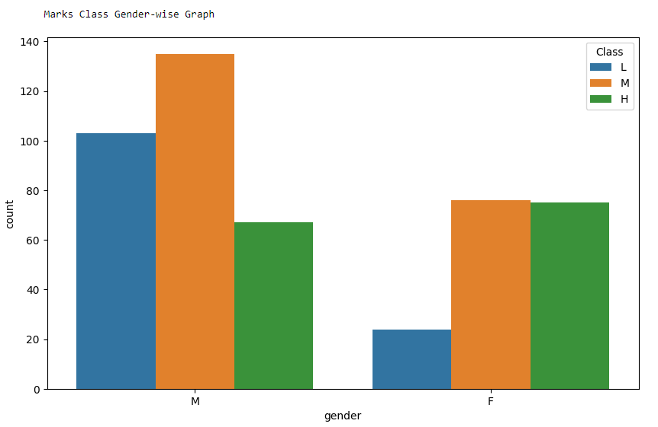
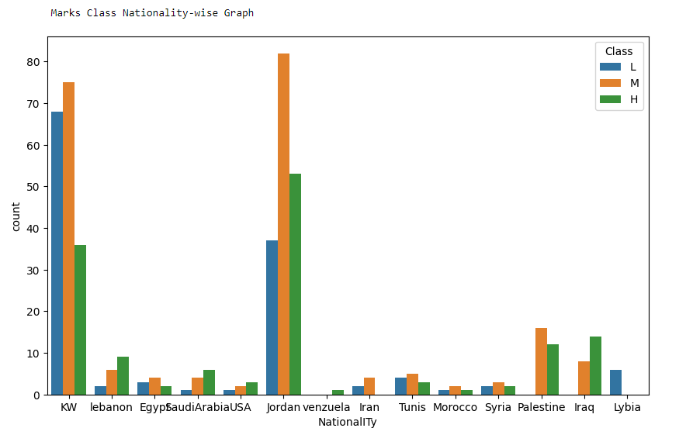
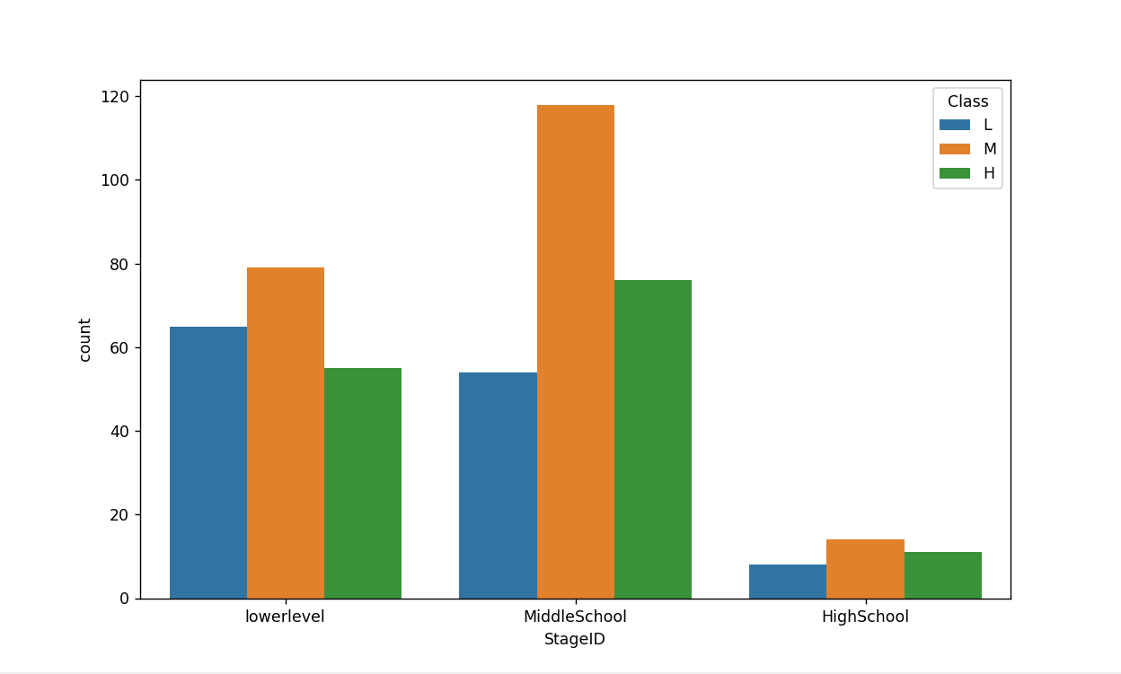
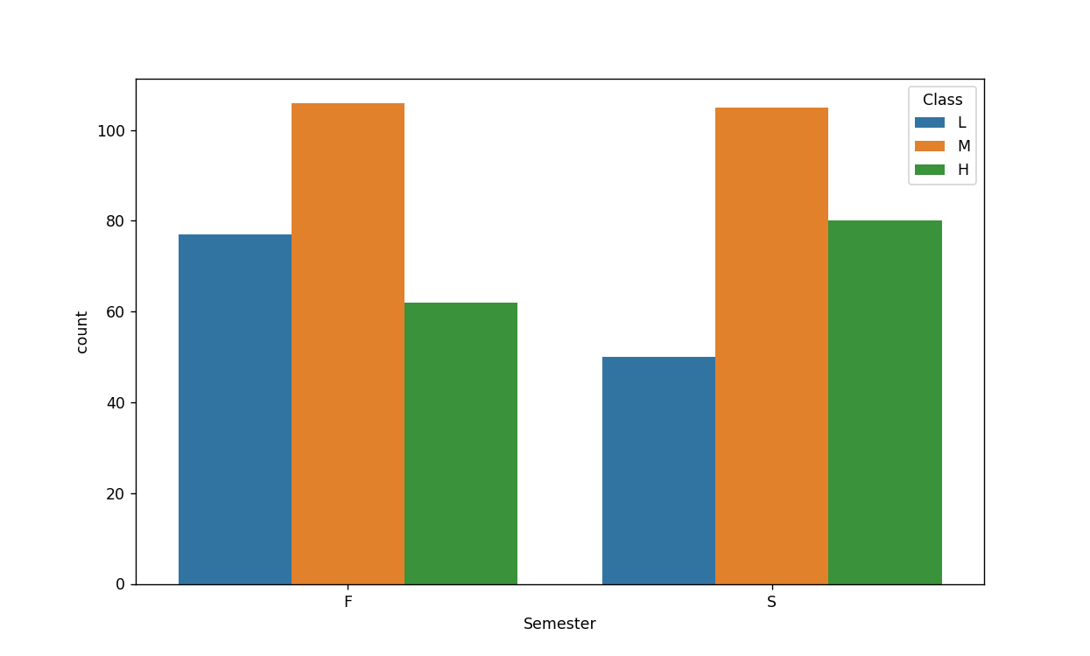
Result

Slide 12
CONCLUSION
Finally, the project ‘Student Performance Prediction using Machine Learning' demonstrated the efficacy of various machine learning algorithms for Student Performance Prediction . The Gradient Boosting Regressor model outperformed all others.
The findings of this project demonstrate the potential of machine learning in the real estate industry. The Gradient Boosting Regressor model accurately predicted house prices with a MAPE of 19.16%.
Several challenges arose during project implementation, including dealing with missing values and outliers in the data, as well as selecting the most relevant features for prediction. However, these issues were addressed using data preprocessing techniques and feature engineering.
This project's potential improvements include investigating more advanced machine learning models, incorporating additional features into the dataset, and fine-tuning the models to improve their performance.
The value of accurate house price predictions cannot be overstated. It ensures that buyers get a fair deal, while it assists sellers in properly pricing their property. It gives real estate agencies and online property listing platforms a reliable estimate to present to their users.

Slide 13
FUTURE SCOPE
The ‘Student Performance Prediction using Machine Learning' project has a bright future ahead. Here are some potential improvements and expansions for the system.
Incorporating Additional Data Sources The model's performance could be improved by including more data sources. For example, data about the class, such as the distance to schools, could be included. Furthermore, macroeconomic factors such as Optimizing the Algorithm for Better Performance: Machine learning models can always be improved. Advanced techniques such as hyperparameter tuning, ensemble methods, and deep learning could be used to improve the model's performance.
Expanding the System to Cover Multiple Cities or Regions: The model is currently being trained on a specific dataset. Expanding the system to include data from multiple cities or regions may improve the model's robustness and applicability.
Emerging technologies, such as edge computing, could be used to bring the model closer to the data source, reducing latency and improving real-time prediction capabilities. Advanced machine learning techniques, such as reinforcement learning or neural networks, could be used to improve prediction accuracy.

Slide 14
References
Research Papers and Articles:
1. Han, J., Kamber, M., & Pei, J. (2011). Data Mining: Concepts and Techniques. Morgan Kaufmann.
2.Romero, C., & Ventura, S. (2010). Educational data mining: A review of the state of the art.
IEEE Transactions on Systems, Man, and Cybernetics, Part C (Applications and Reviews), 40(6), 601-618.
3.Al-Radaideh, Q. A., Al-Shawakfa, E. M., & Al-Najjar, M. I. (2006). Mining student data using decision trees.
Proceedings of the 2006 International Arab Conference on Information Technology (ACIT'2006), Yarmouk University, Jordan.
Machine Learning Textbooks:
1.Géron, A. (2019). Hands-On Machine Learning with Scikit-Learn, Keras, and TensorFlow: Concepts, Tools, and
Techniques to Build Intelligent Systems. O'Reilly Media.
2.Bishop, C. M. (2006). Pattern Recognition and Machine Learning. Springer

Slide 15
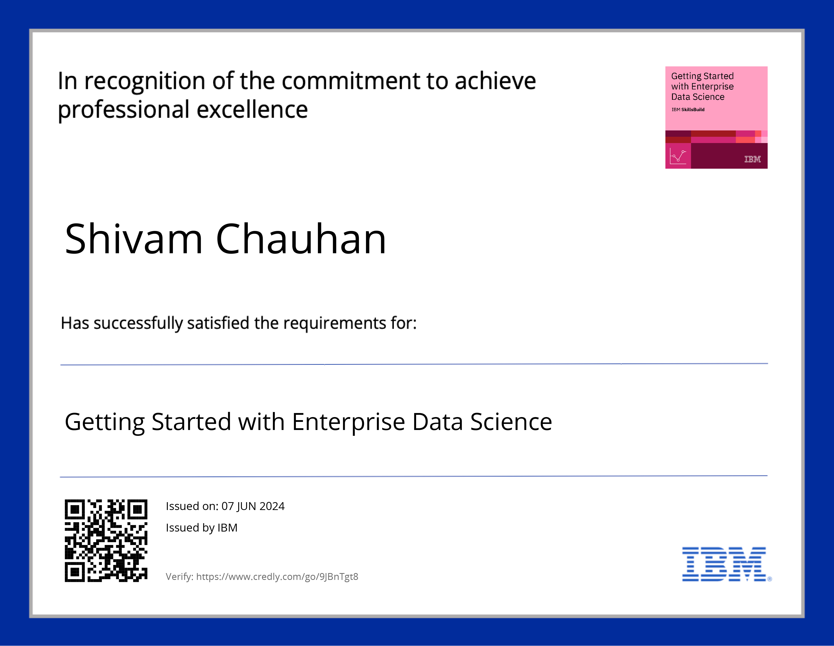
course certificate 1

Slide 16
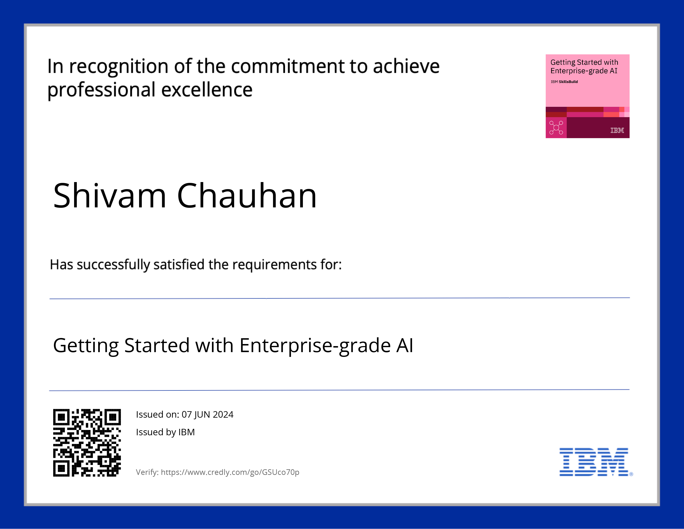
course certificate 2

Slide 17
THANK YOU

